Slide 1
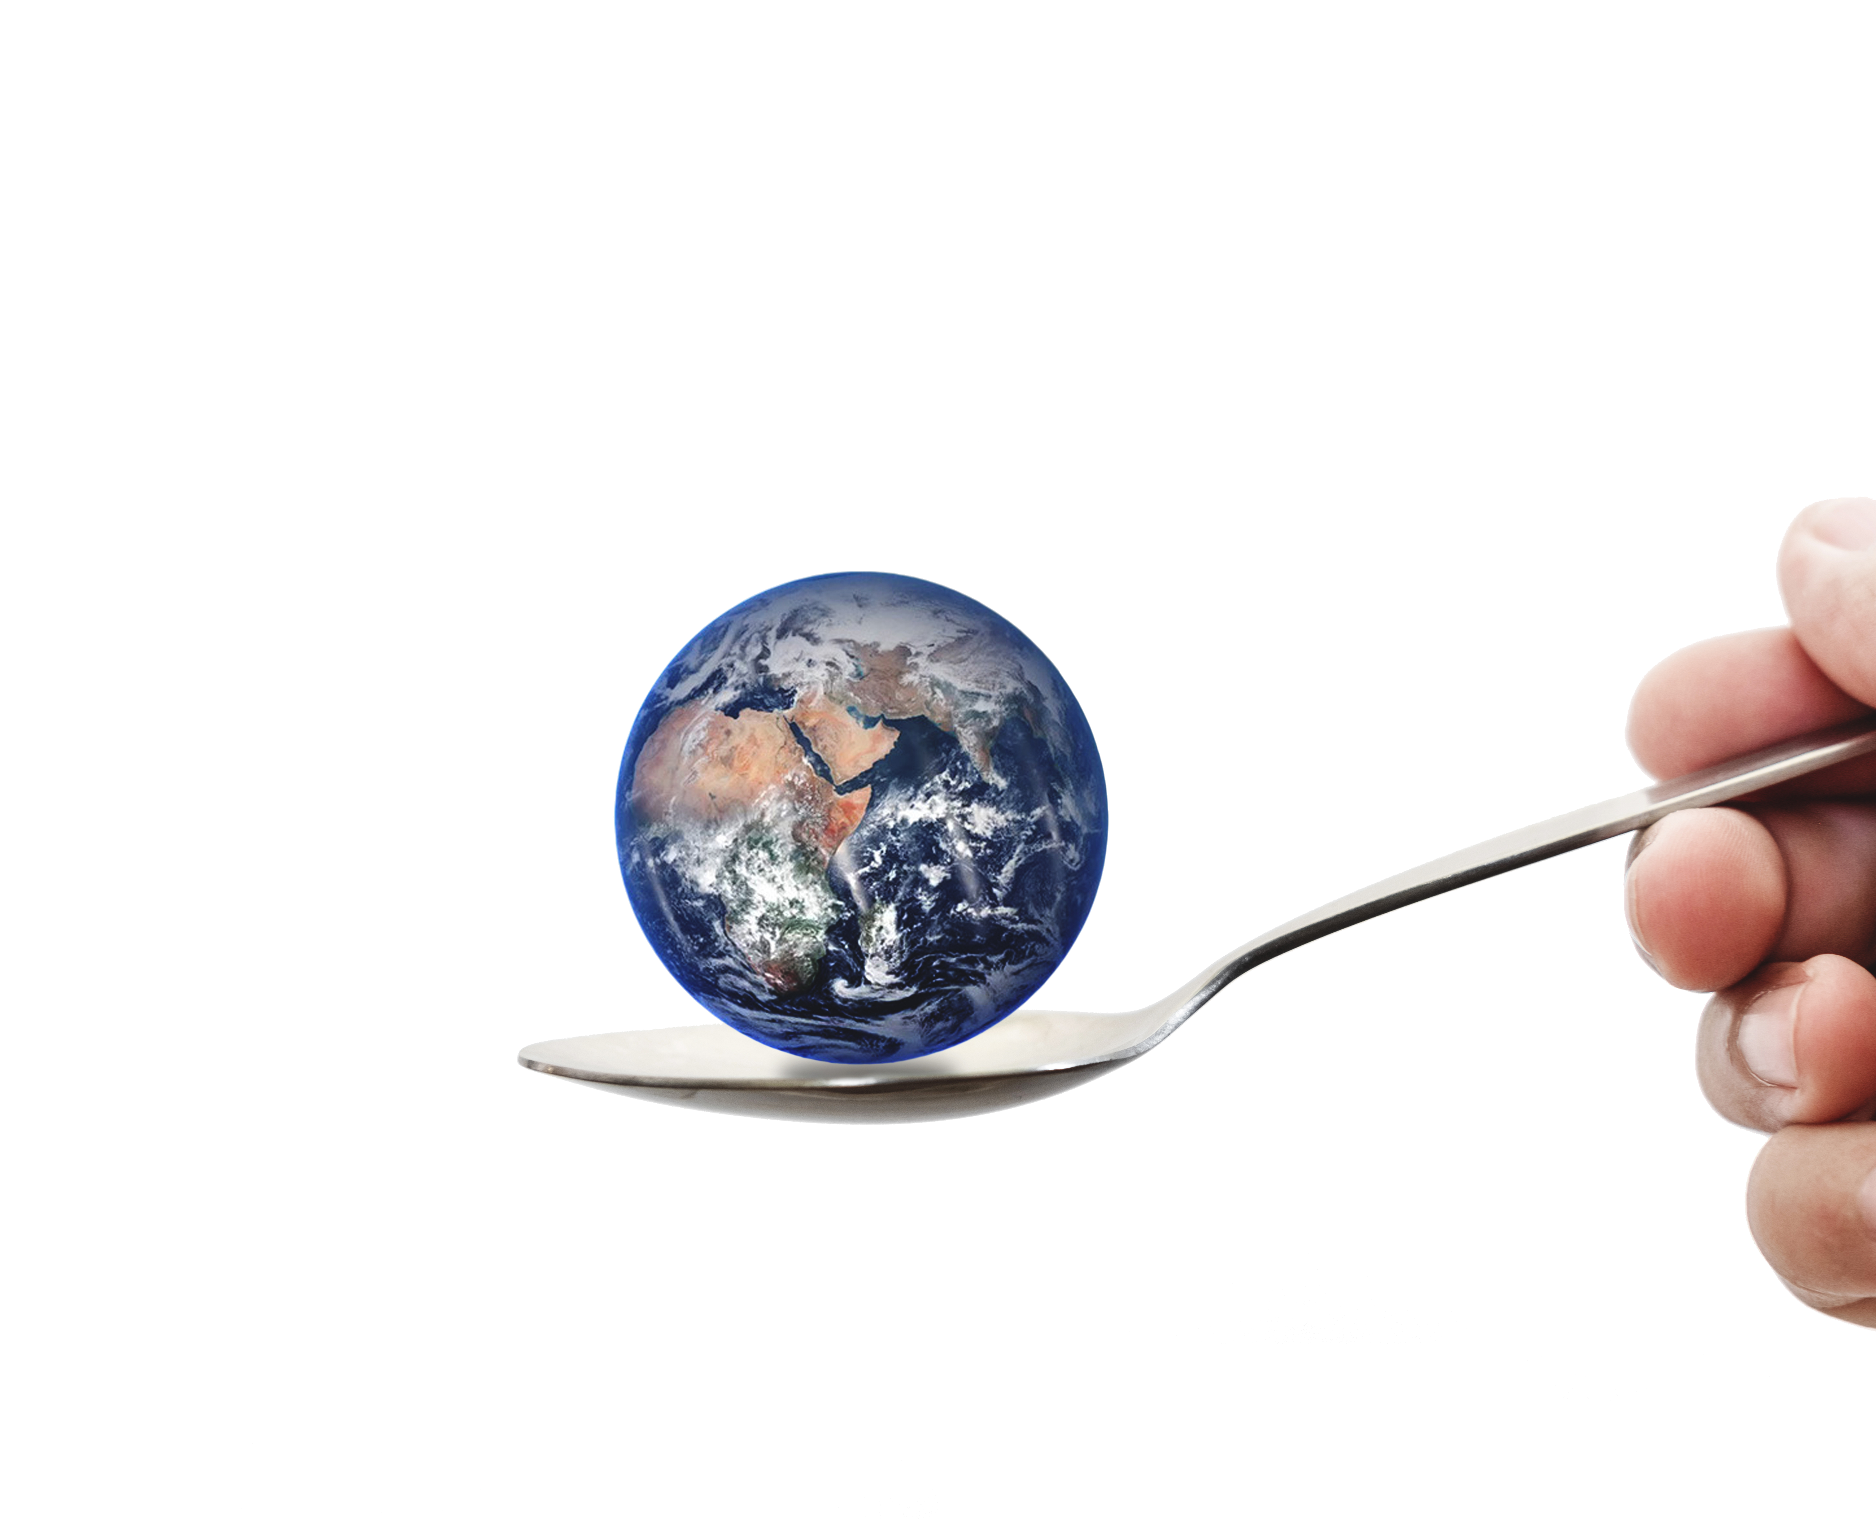
MODULE 3
Innovate your Food Service Business through Improving your Nutritional Offering Ingredients

Slide 2
01
Understanding the links between FOOD – DIET – HEALTH
Module 3
02
Get to know Nutraceuticals
The aim of this module is to increase your skills in on 5 topics that are very important when it comes to Improving Nutrition & the Function of Ingredients in the food you serve.
03
Reducing Sugar & Salt content in food products
04
Natural Additives
05
Reducing the Processing of Food

Slide 3
MODULE 3
1. Understanding the links between
FOOD – DIET – HEALTH

Slide 4
DIET & HEALTH IN EUROPE
The burden of disease associated with poor nutrition continues to grow across Europe.
Poor diet, overweight and obesity contribute to a large proportion of noncommunicable diseases, including cardiovascular diseases and cancer, the two main killers in Europe.
National surveys in most countries indicate excessive fat intake, low fruit and vegetable intake and an increasing problem of obesity, all of which not only shorten life expectancy, but also harm the quality of life.

Slide 5
The Link between Food – Diet – Health
If we get too much food, or food that gives our bodies the wrong instructions, we can become overweight or obese and at risk of developing diseases and serious health conditions.
Examples of such conditions are:
Arthritis
Diabetes
Cancer
Heart disease.
In short, a clear relationship exists between the food that we eat and our well-being.

Slide 6
CLASSIFICATION of OBESITY
OVERWEIGHT
OBESE
MORBIDLY OBESE
BMI
≥25 kg / m²
BMI
≥30 kg / m²
BMI
≥40 kg / m²

Slide 7
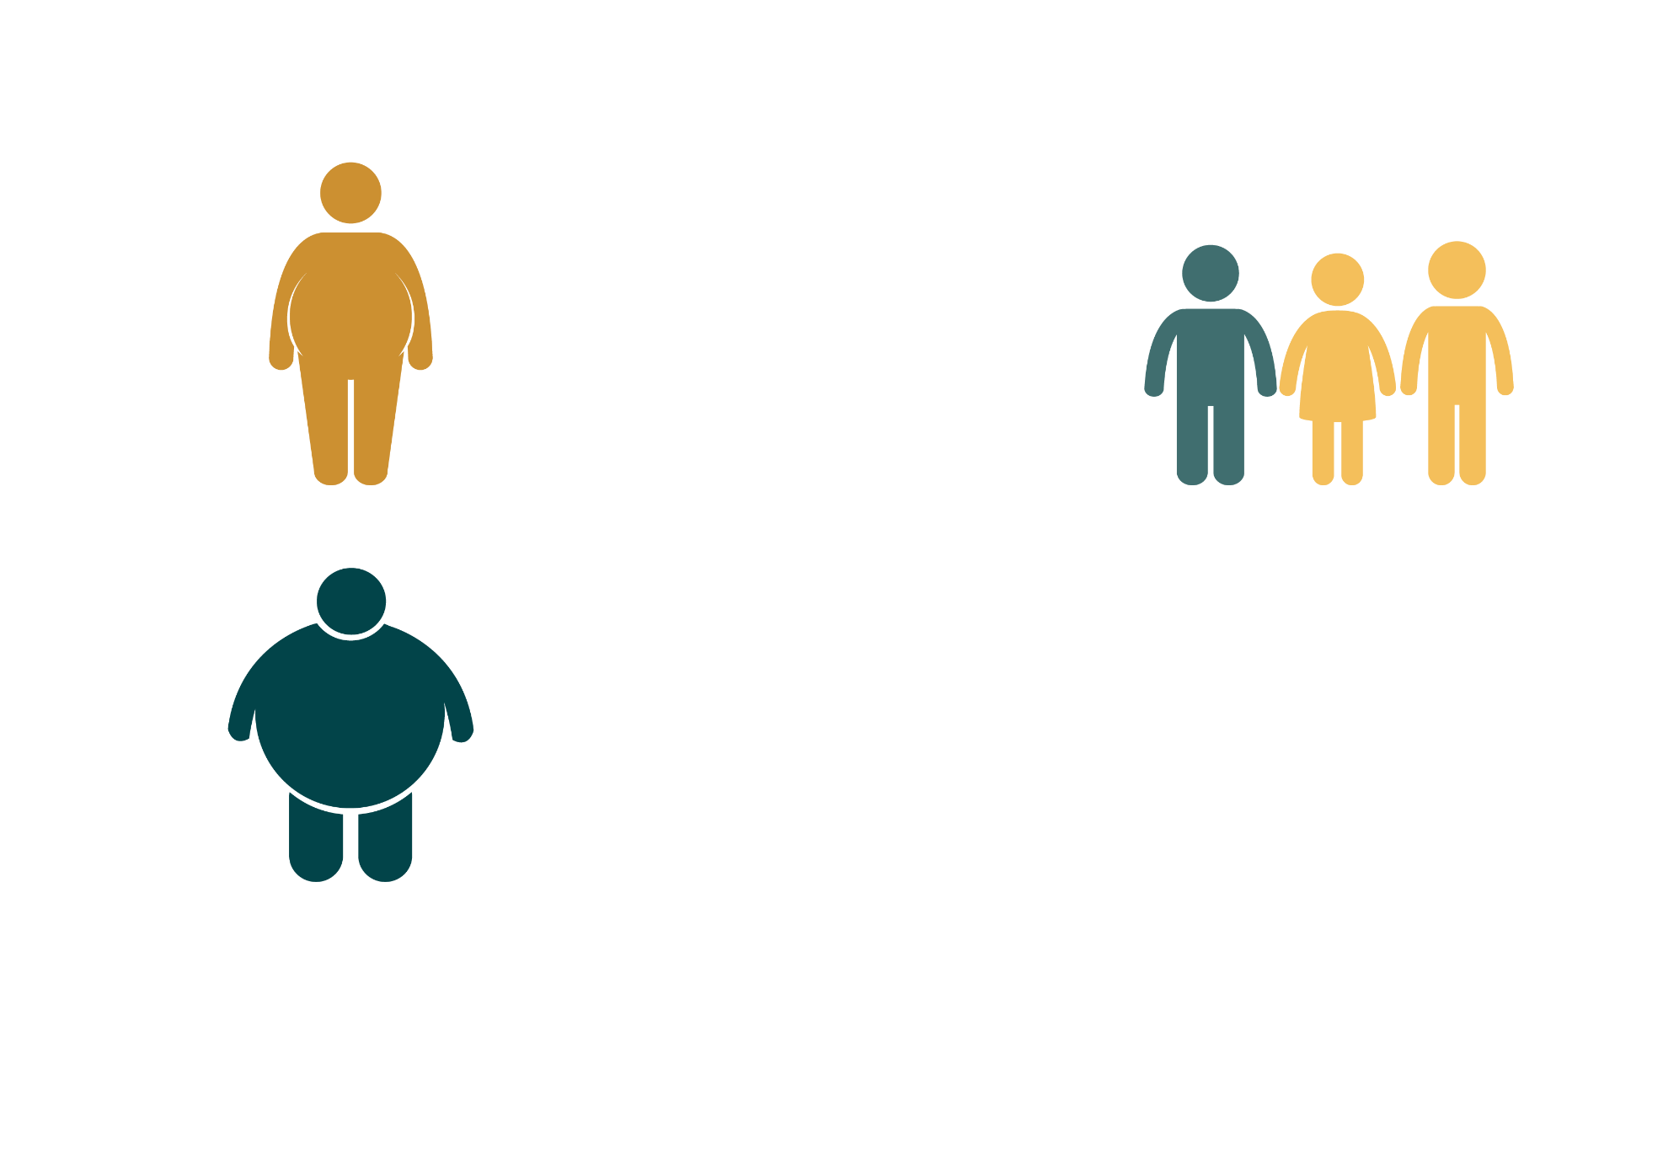
THE CHALLENGE OF OBESITY
Obesity is a major public health problem in Europe & is described by the World Health Organisation as an ‘epidemic’.
IN THE WHO/EUROPEAN REGION
OVER 50%
1 IN 3
of people are overweight or obese
OVERWEIGHT or
OBESE
11-year-old is
OVER 20%
of people are
obese

Slide 8
Why we need change…
Obesity is already responsible for
2–8% of health costs
10–13% of deaths in various parts of the EU . (WHO – Europe)
Weight problems and obesity are increasing at a rapid rate in most of the EU member states, with estimates of 51.6 % of the EU’s population (18 and over) overweight in 2014, and this is increasing (EUROSTAT)

Slide 9
Britain is spending £47bn a year tackling the implications of an overweight population
Obesity is a bigger cost for Britain than war and terror.
Britain spends £47bn a year dealing with the healthcare and social costs of an increasingly overweight population.
(source McKinsey Global Institute) ...

Slide 10
What causes Obesity…
The key causes of obesity are ...
Increased consumption of energy-dense foods high in saturated fats and sugars.
Reduced physical activity.
Our food environment is also a key determinant …
The Harvard School of Public Health Food Environment conducted fascinating research into understanding how the food environment influences our weight. Download their Research by Setting Summary – which looks at risk factors in Families, Workplaces, Schools, Neighbourhoods, Lack of Access to Supermarkets, Greater Access to Convenience Stores and Fast Food.
DOWNLOAD - The Forum at Harvard School of Public Health’s webcast “Why We Overeat: The Toxic Food Environment and Obesity.”

Slide 11
As food service businesses, we have a role to play.
If we align to Health & Wellbeing Top Trends, we also expose a growing market opportunity
Healthy Living
Using Technology
Achieving Balance
This is as much about stripping away the artificial and unnecessary ingredients as it is about adding more ‘good stuff’. Pure and natural products are the order of the day.
Consumers are making use of technologies that manage and measure many aspects of their lifestyle, from water intake, to sleeping, to sugar levels..
Balance is increasingly top of consumers’ agendas. Boundaries between emotional and physical wellbeing blur as people aspire to a holistic ideal of healthy mind and body.

Slide 12
Health and Wellbeing, THE TOP TRENDS
How can you interpret these trends to innovate your food business ?
Pare back Ingredients, processes or packaging to emphasise the naturalness of your Product?
Leverage technology to help consumers make the most of your product & service, and to understand it’s health and energy benefits for adults and children alike!
Make your product customisable, and suitable for a variety of diets and lifestyles? How can it contribute to a holistically balanced lifestyle?

Slide 13
CASE STUDY – BE INSPIRED
A Case study demonstrating the 3 top trends
Camile Thai is innovating the fast-food world by demonstrating that take-away or delivery of ‘fast-food’ can also be healthy food and can be produced in a sustainable and ethical manner. The restaurant chain through its development strategy has supported their franchisees every step of the way to deliver a quality and consistent product. No matter in what location, they are all aligned with the same principles of locally sourced produce, hand-made aromatic sauces and made to order dishes of ‘good mood Thai food’.
Through digitalisation they are going that one step further and promoting health through the use of their App. Here, they provide calorie and macronutrient counts, which are lab tested and certified by Nutritionists. Their website is very much health and nutrition focused.
VISIT https://www.camile.ie/
READ THE FULL STORY https://www.foodinnovation.how/wp-content/uploads/2021/07/5.-Camile-Thai.pdf

Slide 14
Why focus on a Healthy Menu?
According to Nielsen: Consumers are attempting to take charge of their health. Nearly half (49%) of global respondents in Nielsen’s Global Health & Wellness Survey consider themselves overweight, and a similar percentage (50%) is actively trying to lose weight.
They’re looking for help from food and beverage manufacturers and the food service industry to make healthier choices!
In the sections that follow, we bring you on a learning journey of ways you can innovate your food service through Improving Nutrition & the Function of Ingredients in the food you serve.

Slide 15
Nutrients are our friends!
Nutrients are the nourishing substances in food that are essential for the growth, development and maintenance of body functions. Essential meaning that if a nutrient is not present, aspects of function and therefore human health decline. When nutrient intake does not regularly meet the nutrient needs dictated by the cell activity, the metabolic processes slow down or even stop.
- Perspectives in Nutrition, Wardlow and Insel

Slide 16
MODULE 3
2. Get to know Functional Foods and Nutraceuticals

Slide 17
Functional foods
One familiar functional food example is oatmeal, which contains soluble fibre. This sort of fibre can help lower cholesterol levels and support heart health. Foods and beverages classified as functional include the following examples:
Whole or conventional foods: including grains, fruit, vegetables, nuts
Modified foods: including fortified, enriched, or enhanced foods such as yogurt, milk, and orange juice
Food ingredients: includes isolated or synthesized food ingredients such as those that provide prebiotic effects
Let’s look at some examples of key ingredients to add this food functionality….

Slide 18
Get to know Functional foods
Functional foods are natural foods enriched with additive minerals, vitamins or healthy fats through the aptly named process of 'nutrification’. A functional food is a food claimed to have an additional function (often one related to health promotion or disease prevention) by adding new ingredients or more of existing ingredients e.g. added vitamins and minerals. Think of milk fortified with vitamin D and yogurt with probiotics.
However, most food is considered functional due to the fact that physical benefits such as protein for muscle function or carbohydrates for energy can be derived from their ingredients. What separates truly exceptional functional foods from the others is an impressive nutrient profile. In other words, the vitamins and minerals that nourish at the cellular level can truly feed the body deeply, and the resulting effect on overall health when combined with a well-balanced diet is enjoyed.

Slide 19
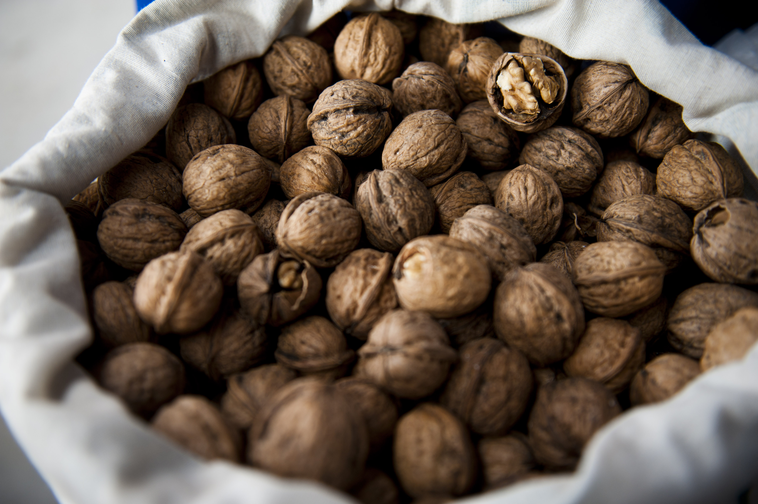
Examples of Functional Foods
Nuts
Nuts have an impressive list of health benefits. Beyond being nutritious as an additional ingredient, nuts also provide higher levels of omega-3 fatty acids.
Most nuts also have higher amounts of fibre, vitamin E, and other important minerals. They can assist in weight loss, protect the heart, and help in diabetes management.
Promoting overall health, they also reduce inflammation (unless an individual has an allergy to nuts), support brain health, and decrease cancer and chronic disease risk. Walnuts in particular are praised for supporting heart and brain health.
This Photo by Unknown Author is licensed under CC BY-SA

Slide 20
Examples of Functional Foods
Whole Grains
These grains provide a variety of health benefits because they literally are the whole package. Grains have three main parts, and the refining of grains into products such as white bread or white rice strips these important, nutrient-filled layers away.
Whole grains have all three layers, which helps it to keep the body healthy, reduce disease risk, and help prevent chronic conditions. Whole grain products that are high in fibre and low in added sugars can also improve digestive health while protecting against inflammation.
Some common whole grains include:
Amaranth
Barley
Oats and oatmeal
Brown rice
Whole-grain pasta
Whole-grain bread
Quinoa
Teff

Slide 21
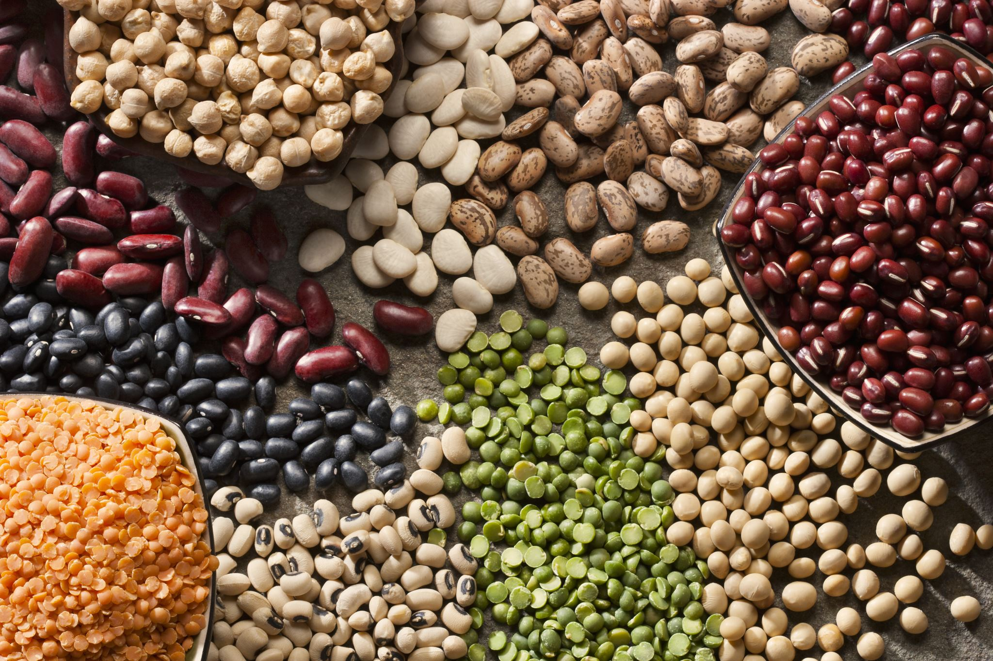
Examples of Functional Foods
Beans
High in fibre , protein, and nutrients like potassium and folate, beans without added salt can be a significant source of vitamins and minerals. Using them as a functional food is most effective if they are rinsed and drained before use. This reduces the sodium (salt) content if salt has been added to the beans during processing or packaging.

Slide 22
Examples of Functional Foods
Probiotic Foods
Probiotics are live cultures commonly known as “good” bacteria that promote gut health. Probiotics are naturally occurring in some functional foods, including the following:
Fermented dairy foods:
Kefir
Yogurt
Aged cheeses
Fermented non-dairy foods:
Kimchi
Sauerkraut
Miso
Cultured non-dairy yogurts (i.e. coconut or almond milk-based yogurt alternative products)

Slide 23
Conventional functional foods are natural, wholefood ingredients that are rich in important nutrients like vitamins, minerals, antioxidants, and heart-healthy fats.
Fruits: berries, kiwi, pears, peaches, apples, oranges, bananas
Vegetables: broccoli, cauliflower, kale, spinach, zucchini
Nuts: almonds, cashews, pistachios, macadamia nuts, Brazil nuts
Seeds: chia seeds, flax seeds, hemp seeds, pumpkin seeds
Legumes: black beans, chickpeas, navy beans, lentils
Whole grains: oats, barley, buckwheat, brown rice, couscous
Seafood: salmon, sardines, anchovies, mackerel, cod
Fermented foods: tempeh, kombucha, kimchi, kefir, sauerkraut
Herbs and spices: turmeric, cinnamon, ginger, cayenne pepper

Slide 24
Modified Functional Foods
Modified functional foods are those fortified with additional ingredients, such as vitamins, minerals, probiotics, or fiber to increase the food’s health benefits.
fortified juices
fortified dairy products, such as milk and yogurt
fortified milk alternatives, such as almond, rice, coconut & cashew milk
fortified grains, such as bread and pasta
fortified cereals and granola
fortified eggs e.g. Omega 3

Slide 25
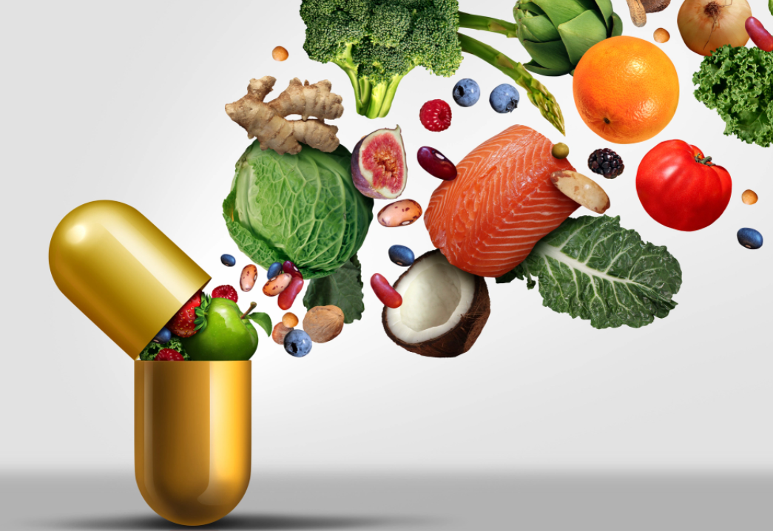
What are Nutraceuticals?
Nutraceutical (from nutrition + pharmaceutical) is any substance that may be considered a food or concentrated compound obtained from food sources which can provide medicinal or health benefits, including the prevention and treatment of disease.
A nutraceutical provides health benefits beyond basic nutrients, it can be considered as functional food that is fortified with added or concentrated ingredients to functional levels, which improves health or performance.

Slide 26
Examples of Nutraceuticals
Click hyperlinks for more information…
According to Nutrients Review, nutraceuticals can include:
Minerals, vitamins and other dietary supplements
Herbal products: garlic (allicin), ginger, echinacea, ginseng, liquorice, onion, senna, turmeric (curcumin)
Dietary enzymes: bromelain, papain
Dietary fibre
Hydrolysed proteins
Phytonutrients: resveratrol
Carotenoids: lycopene
Prebiotics / Probiotics

Slide 27
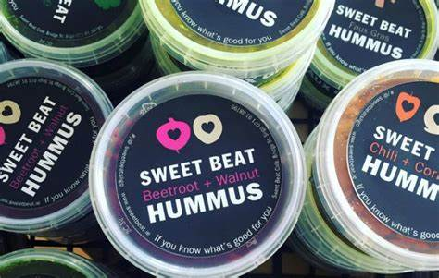
How to promote the use of Nutraceuticals in your business…
Advice from Hospitalitynet is to express added nutrients in terms of consumer benefits. This prevents customer confusion and intimidation
With any nutraceutical addition to your food service business, customer education is a must. This means that first you need to have knowledgeable and confident staff to discuss your product extras & second it's an opportunity to develop rapport with patrons.
READ: SWEET BEAT CAFÉ, IRELAND case study
https://www.foodinnovation.how/wp-content/uploads/2021/07/SUSTAIN-Compendium_Page_59-212x300.jpg
Sweet Beat Super Salad | Sweet Beat Sligo
Buddha Bowl | Sweet Beat Sligo

Slide 28
Demand for functional foods
Nowadays, foods are not intended to only satisfy hunger & to provide necessary nutrients, but they can confer additional health benefits, preventing nutrition-related diseases, and improving physical and mental well-being.
The recent technological advancement, the socio-economic trends, and the population lifestyle modifications throughout the world indicate the need for Foods with increased health benefits. As we saw in Module 1, this trend is increasing for the post Covid-19 consumer.

Slide 29
What can you & your food business do?
By incorporating conventional functional foods into your menu items, you will already be making an impact to the health of your customer.
Going a step further means you can add modified functional foods or nutraceuticals. This is a great proactive step as a way forward to improve the community’s health but also if done correctly to improve your brand positioning in the Food Service market.
This café in Wicklow, Ireland is an excellent example of how to do it well. https://www.vitalhealthgroup.ie/shop

Slide 30
MODULE 3
3. Reducing Sugar & Salt Content in Foods

Slide 31
SUGAR & SALT CREEP
Food service businesses have a key role to play in reducing sugar and salt content in food.
WHO recommends we eat a healthy diet throughout our life to help prevent all forms of malnutrition (wasting, stunting, underweight, inadequate vitamins or minerals, overweight, obesity), as well as preventing a range of diet-related noncommunicable diseases (such as heart disease, stroke, diabetes and some cancers), and lower our risk of infectious diseases.
But the increased consumption of processed food, rapid urbanization and changing lifestyles have led to a shift in dietary patterns. People are now seeking out more foods high in free sugars & salt/sodium.

Slide 32
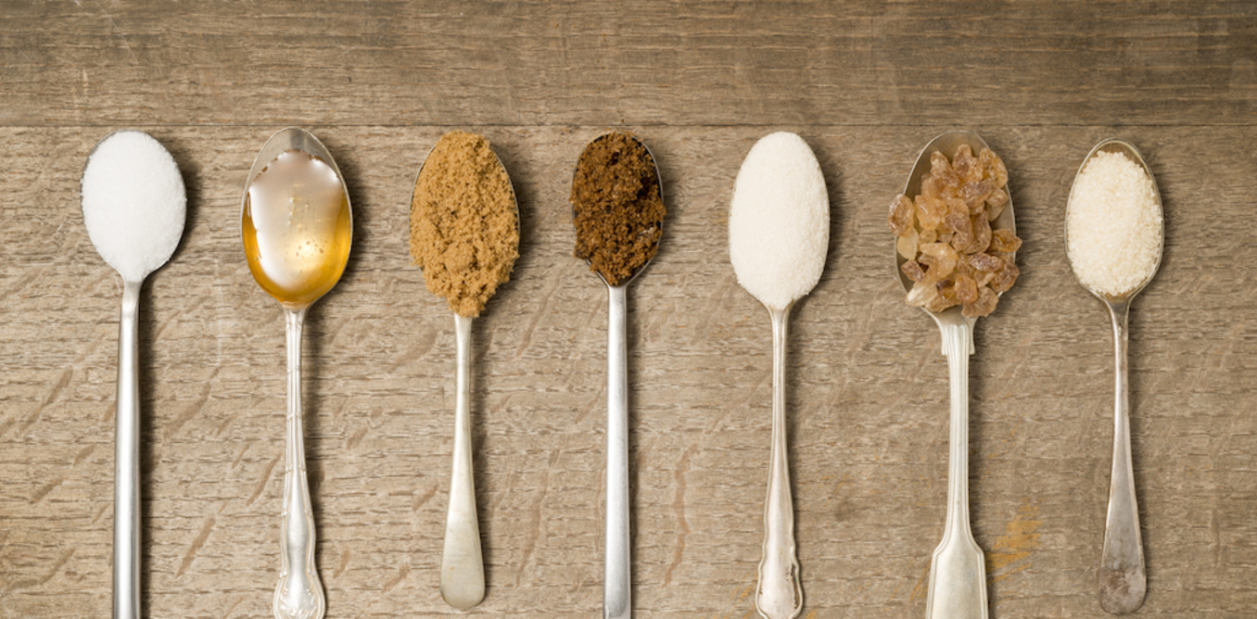
Reducing intake of Free Sugars
Free sugars are all sugars added to foods or drinks (e.g. glucose, galactose, fructose, sucrose or table sugar) by the cook or consumer, as well as sugars naturally present in honey, syrups, fruit juices and fruit juice concentrates.
Consuming free sugars increases the risk of tooth decay.
Excess calories from foods and drinks high in free sugars also contribute to unhealthy weight gain, which can lead to overweight and obesity.

Slide 33
Helping our consumers reduce their intake of Sugar
Smaller portion
sizes
Don’t put sugar on tables
Offer low sugar alternatives
Smaller portion sizes limits the intake of sugar by taking control for them
Often if it is difficult for them to add sugar, they will choose to avoid it.
Especially drinks. Offer water, milk, small portions of fresh juices instead of high sugar soft drinks etc

Slide 34
Learning about Sugar in foods…
WATCH
And the effects of too much
Here Dr. Uma Naidoo from Harvard Medical School speaks about sugars in food and which to avoid and the effects of too much sugar in the diet.
https://www.youtube.com/watch?v=fVAEgzXXLVs

Slide 35
Get to know Natural Sweeteners
Natural sweeteners, in comparison to non-nutritive (artificial) sweeteners contain calories and nutrients, are metabolized, and change as they pass through the body. They include:
agave nectar
brown rice syrup sugar
coconut
date sugar
honey
maple syrup
molasses and blackstrap molasses,
sorghum syrup
stevia.

Slide 36
5 million global deaths could be prevented each year if people’s salt consumption were reduced to the recommended level of less than 5 g per day
Source: World Health Organisation (WHO)

Slide 37
Reducing intake of Salt
People are often unaware of the amount of salt they consume.
Most salt comes from processed foods (ready meals; processed meats & salty snacks) or from food consumed frequently in large amounts (bread).
Salt is also added to food during cooking (bouillon, stock cubes, soy sauce and fish sauce) or at the table (table salt).
The WHO recommends we reduce salt consumption to a level of < 5 g per day.
Most people consume too much sodium through salt (average of 9–12 g of salt per day) and not enough potassium.
High salt consumption and insufficient potassium intake (less than 3.5 g) contribute to high blood pressure, which in turn increases the risk of heart disease and stroke.

Slide 38
Helping our consumers reduce their intake of Salt
Only add salt at customer’s request
Source low salt ingredients
Smaller portion sizes
By limiting or eliminating the use of salt during cooking it will significantly help
Low salt breads, meats, cheeses, sauces etc will make an impact
This can mean the no. of calories as well as the salt content will be reduced

Slide 39
Meet the No Salt Chef
Following his diagnosis with a heart condition five years ago, Brian completely changed his life and cooking style, establishing a reputation for himself as “The No Salt Chef” and cooking great tasting, accessible and affordable food, without adding salt.
CLICK Logo to learn more
Having experienced increasing demand from people who have met and attended his cookery demonstrations across Ireland, Brian fulfilled a long-held dream opening Ireland’s first ‘No Salt’ Cookery School.

Slide 40
MODULE 3
4. Using Natural Food Additives

Slide 41
Food Additives
According to the European Food & Safety Authority (EFSA), food additives are substances added intentionally to foodstuffs to perform certain technological functions, for example to colour, to sweeten or to help preserve foods.
There are various groups of food additives:
- Antioxidants - Preservatives - Food colourants - Sweeteners - Flavour enhancers - Emulsifiers, stabilisers, thickeners & gelling agents - Other.

Slide 42
What are Food Additives?
WATCH
Source: European Food Information Council (EFIC)
Here, the EFIC explain what food additives are and why they are used.
https://www.youtube.com/watch?v=Hy3-QHhzvPE&t=108s

Slide 43
Categories of Food Additives:
Additives may be natural, nature identical or artificial.
Natural additives are substances found naturally in a foodstuff and are extracted from one food to be used in another (beetroot juice can be used to colour other foods such as sweets).
Nature identical additives are man-made copies of substances that occur naturally. (benzoic acid is a found in nature but is also made synthetically & used as a preservative).
Artificial additives are not naturally present in foods & are made synthetically. (azodicarbonamide, a flour improver that is used to help bread dough hold together).

Slide 44
TYPES OF ADDITIVES AND THEIR FUNCTION:
Antioxidants – decreases the chance of oils and fats in foods from combining with oxygen and changing colour or turning rancid. Rancid fats smell and taste unpleasant and are a health risk. Antioxidants are also used in fruits, vegetables and juice to extend the shelf life. Vitamin C (ascorbic acid) is one of the most widely used antioxidants (link to vitamin C).
Preservatives – are used to help keep food safe to eat for longer. Any processed food with a long shelf-life is likely to include preservatives, unless another way of preservation has been used, such as freezing, canning or drying. Traditional methods using sugar, salt and vinegar are still used to preserve some foods.
Colours – are used to make food look more appetizing. During food processing, colour can be lost so additives are used to restore the original colour, they can also be used to make the existing food colour brighter.

Slide 45
TYPES OF ADDITIVES AND THEIR FUNCTION:
Flavour enhancers – are used widely in savoury foods to enhance the existing flavour in the food. Monosodium glutamate is an example of a flavour enhancer.
Sweeteners – are either intense or bulk. Intense sweeteners (for example saccharin & aspartame) are many times sweeter than sugar and so are only used in tiny amounts. This makes them suitable for use in products such as diet drinks, which are very low in energy. Bulk sweeteners (such as sorbitol and sucralose) have a similar sweetness to sugar so are used in similar amounts to sugar in foods.
Emulsifiers, stabilizers, gelling agents and thickeners – emulsifiers help blend ingredients like oil and water that would normally separate; stabilisers prevent them from separating again. They are used in foods such as ice-cream. Gelling agents are used to give foods a gel-like consistency, while thickeners increase the viscosity of foods.

Slide 46
Consumers are looking for safe food with natural ingredients and great taste. They are asking for ingredients they can understand, simple labeling, balanced nutrition panels, and trustworthy sourcing.
Michael Matthews, Business President, Food Protection & Fermentation at Kerry

Slide 47
The Power of Colour
As mentioned in Module 1, the colour of food and drink products strongly influences purchasing attitudes and behaviours of consumers. According to a Sensient national survey, 63% of consumers would be more likely to purchase a brand that replaced artificial colours with colours from natural sources.
Food colour connects consumers with values and specific attitudes; it has the power to be empowering.

Slide 48
The Power of Colour…eating the rainbow
Table for Two: My Smartphone and Me
As food and beverage posts on social media platforms like Instagram and Pinterest climb into the millions and billions, colourful food and drinks are attention-grabbing. Mintel found that colour is a key aspect of “shareable” food and drink, and that food and drink ingredients have inspired current colour trends in fashion, home décor, media, and other viral content (2019).
There is continuing opportunity for food service SMEs to innovate using visual appeal versus traditional flavour line extensions in response to a more visually-oriented society that is spending more time on social media platforms

Slide 49
The Power of Colour
1. Colour connects the consumer to causes & community
2. Colour provides indicators to consumer health benefits

Slide 50
The Power of Colour
3. Colour promotes Seasons & occasions
4. Colour Portrays Value & Lifestyle

Slide 51
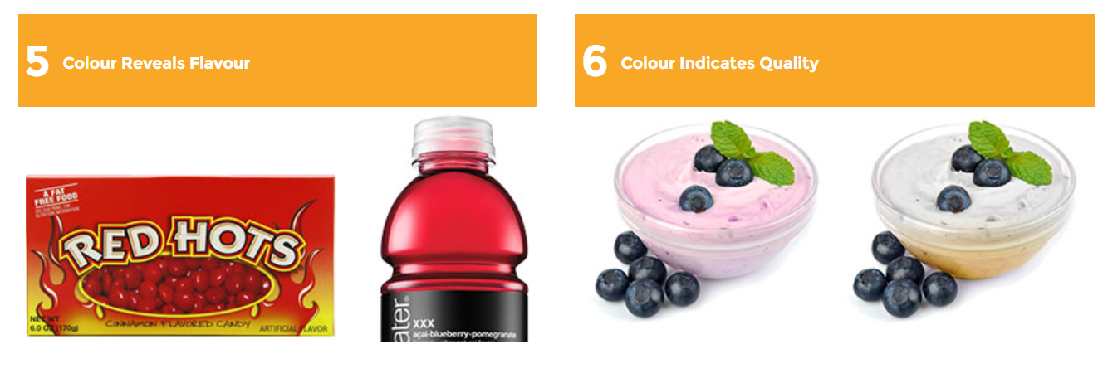
The Power of Colour
5. Colour reveals or indicates Flavour
6. Colour indicates Quality & freshness

Slide 52
Natural Food Colourants:
Natural food colours originate from a wide range of sources like vegetables, fruits, plants, minerals and other edible natural sources. They impart colour when added to food or drink.
Natural food colours are preparations obtained by physical and/or chemical extraction resulting in a selective extraction of the pigments relative to the nutritive or aromatic constituents.
They come in many forms consisting of liquids, powders, gels, and pastes.

Slide 53
Some examples of Natural colourants:
E163 Anthicyanins are red, purple and blues derived from grapes, berries & red cabbage Often used in drinks, jams & sugar confectionery
E162 Betanin is a deep Purple derived from beetroot, it works well in frozen, dried & short shelf-life products like yogurt
E120 Carminic Acid is red and derived from female cochineal insects it is used in alcoholic drinks & processed meat products
E140 Chlorphyll is green and found in all green leafy vegetables Used is confectionery and dairy products
E160 Cartenoids are yellow/ orange / red colours derived from carrots, prawns, red peppers, saffron etc. It is used in butter and other dairy products & soft drinks
E100 Curcumin is a yellow derived from the root turmeric it is often used in pickles, soups & confectionery

Slide 54
Plant-derived food preservatives is the new trend:
In the early days, some of the natural preservatives, such as citrus fruit juices, salt, sugar and vinegar, were traditionally used to preserve food. With the evolutionary changes, the food industry has been looking at using plants and their extracts as potential means to food preservation.
5 potential clean-label, plant-derived alternatives to some chemical preservatives:
1: Australian Kakadu plum
2: Rosemary plants
3: Moringa oleifera
4: Naturally occurring parabens
5: Verdad F32
https://www.prescouter.com/2018/04/natural-alternatives-chemical-food-preservatives/

Slide 55
Food Unwrapped…
WATCH
Rosemary extract as a natural additive
Here, Kate Quilton discovers Rosemary extract and its why it is used as a food additive
https://www.youtube.com/watch?v=liOI5FsOUBc

Slide 56
How can Food Service SMEs help??
01
KEEP THE CUSTOMER INFORMED
By following these trends Food SMEs can become more sustainable themselves
By giving the customer what they want SMEs are contributing to cleaner food and a green economy
02
SOURCE INGREDIENTS ACCORDINGLY
03
THINK NATURAL OR ORGANIC

Slide 57
MODULE 3
5. Reducing Food Processing

Slide 58
PROCESSED FOODS
A processed food is any food that has been altered in some way during preparation.
Food processing can be as basic as:
freezing
canning
baking
drying
Not all processed foods are unhealthy, but some processed foods contain high levels of salt, sugar and fat.

Slide 59
Why we process food…
Almost all food is processed in some way before it is eaten.
Commercially, the main reasons to process food are:
to eliminate micro-organisms (which may cause disease) such as pasteurizing milk.
to extend shelf life.
to make them suitable for use, such as pressing seeds to make oil.
Simply cooking or combining a food with other foodstuffs to create a recipe is also considered a form of food processing.

Slide 60
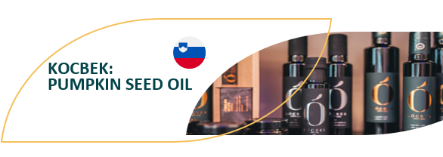
CASE STUDY – BE INSPIRED
A Slovakian Case study of GOOD food processing making Pumpkin Seed Oil
The owners of KOCBEK pride themselves on their quality product made using traditional methods and they supplemented their signature pumpkin oil with other quality products. Their pumpkin oil is now being promoted correctly worldwide, as a quality artisan product and it is competing well against the popular olive oils.
Organic and local farmers supply of pumpkin seeds to the Kocbek Oil mill & they follow sustainable production, processing, and distribution of their seeds. Particular attention is paid to integrating natural methods and the circulation of substances in nature. They have received a certificate of protected geographical indication for their Pumpkin Oil.
VISIT https://kocbek.si/en/
READ THE FULL STORY https://www.foodinnovation.how/wp-content/uploads/2021/08/52-Kocbek.pdf

Slide 61
What makes some processed foods less healthy?
Ingredients such as salt, sugar & fat are sometimes added to processed foods to make their flavour more appealing & to extend their shelf life, or to contribute to the food's structure, such as salt in bread or sugar in cakes.
Buying these foods can lead to people eating more than the recommended amounts of sugar, salt & fat as they may not be aware of how much has been added to the food they are buying and eating.
These foods can also be higher in calories due to the high amounts of added sugar or fat in them.

Slide 62
Categorisation of Processed foods
The NOVA system, an increasingly used food classification system in public health nutrition-related research, it categorises food products into four groups according to their level of processing.
unprocessed and minimally processed foods.
processed culinary ingredients, which includes oils, butter, sugar, lard & salt.
processed foods, which are made by adding salt, oil, sugar or other substances from the second group to foods from the first group.
ultra-processed foods (UPFs), which include soft drinks, confectionery, sweet biscuits, ice-cream, and savoury snacks

Slide 63
Different pathways in the food value chain based on the level of processing of end-products
Food Producers: Farmers, agricultural workers, commodity producers etc.
Packers, millers,
crushers, refiners,
etc.
Synthetic food
Ingredient manufacturers
Primary food processors
Secondary food processors
Processed and ultra-processed food
manufacturers
Nova Group 2
Processed culinary
ingredients
Nova Group 3
Processed
foods
Nova Group 4
Ultra-processed
foods
Nova Group 1
Unprocessed or
minimally processed
foods
Food retailers
and service outlets
Supermarkets, independent retailers, wet / produce / farmers markets, quick service restaurants, other restaurants etc.
End-product level of processing
https://globalizationandhealth.biomedcentral.com/articles/10.1186/s12992-021-00667-7

Slide 64
Getting the Balance right…
WATCH
Ultra Processed Foods (UPFs)
.
In this short video Dr. Robert Lustig speaks about UPFs and what they do to our bodies.
https://www.youtube.com/watch?v=_3UUR6FWCPA

Slide 65
How can Food Service SMEs help?
By using less foods from Nova groups 3 & 4
By using less salt, sugar & fat when preparing food
By keeping informed & informing the customer
Sourcing good quality ingredients in their natural state

Slide 66
A Human Experiment
WATCH
A diet of 80% UPFs
A UK Doctor performs a Human Experiment on himself where he eats only processed food for 30 days.
https://www.youtube.com/watch?v=T4PFt4czJw0

Slide 67
In summary..
cook & serve real food
Food service SMEs can help to be more mindful in a post pandemic world to promote healthier eating habits & becoming more sustainable by:
Supporting their customers needs
Providing healthier alternatives
Using less additives
Avoiding UPFs
Sourcing locally
Sourcing fresh & quality

